Slide 1
DERBY RAILWAY ENGINEERING SOCIETY
INTRODUCING THE SOCIETY

Slide 2
INTRODUCTION
This presentation:
  will inform you and your staff about the Derby Railway Engineering Society (DRES).
  will allow you to gain an understanding of what you and your staff will gain from the Society.

Slide 3
ABOUT DERBY RAILWAY
ENGINEERING SOCIETY (DRES)
Designed to encourage interchange of technical expertise amongst all the railway disciplines of its engineering staff, the Midland Railway Engineering Club was started in October 1908.
In 1923, the many railways companies existing at that time amalgamated to form just 4 large companies and the name of the Club was changed to The Derby Railway Engineering Club to reflect Derby as being the headquarters of the newly created London Midland and Scottish Railway.
By 1950, the membership had grown to 300 and reached its
maximum of some 630 in the 1970s.

Slide 4
ABOUT DERBY RAILWAY ENGINEERING SOCIETY (DRES)
In the following years, the scale of the railway industry in Derby gradually diminished, falling abruptly with railway privatisation. As a result, the title was changed to the current Derby Railway Engineering Society to reflect its current remit.
The Society forms an informal link between otherwise separate organisations to benefit from sharing information and expertise; in much the same way as it served the technical staff of the Midland Railway Company in 1908.
In 2008, the Society celebrated its centenary with special events including a reception and separate lecture at the Derby Council House.
Today, the membership numbers stand at over 200.

Slide 5
THE REMIT OF THE SOCIETY
To promote interest and employment in the railway industry by focussing on:
  all aspects of the Railway including its operation; and
  the value of the role of engineering within the railway industry
To ensure new talent enters the railway industry, and in particular:
  promoting the rail industry to schools and colleagues
  promoting further education in engineering and
  promoting railway engineering as worthwhile and rewarding career
To make the Society relevant, inclusive and appropriate to all colleagues within the railway industry.
The Society currently has an increased focus on how it can attract and retain ‘younger’ colleagues and promote the benefits of the railway industry within schools, colleges and universities.

Slide 6
CURRENT SOCIETY ACTIVITIES
The Society has a full and varied schedule of events including:
  An engaging and highly relevant lecture programme geared around the latest technical and development within the industry.
  Technical visits.
  Networking and social events.
  An annual study tour.
  A formal Annual Dinner.
  Events in support of promoting engineering in local schools and colleges.

Slide 7
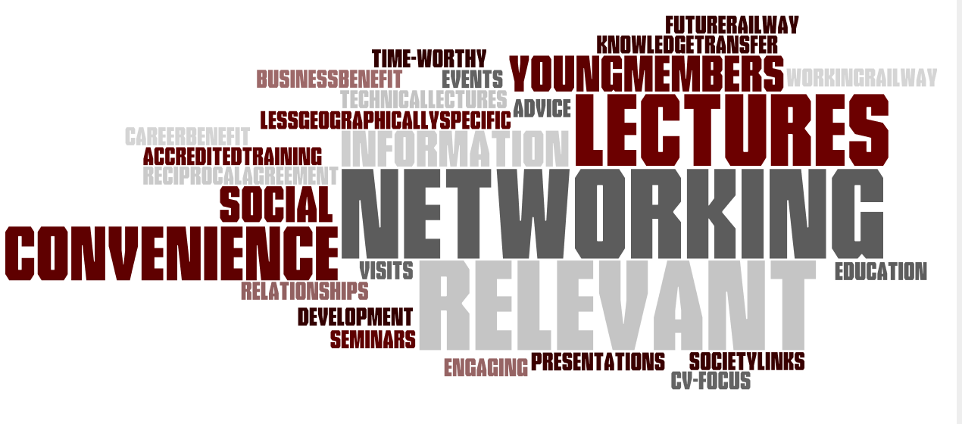
HOW DOES DRES BENEFIT LOCAL EMPLOYERS?
1. Education
Improving technical knowledge and understanding through technical lectures and visits
Educating through relevant, engaging & convenient lectures
Sharing rail knowledge & expertise to aid industry/college performance
Attendance certificates are provided to form part of an employee’s CPD activities
2. Career Progression Opportunity
Networking events for active professionals and potential/future rail workers
To give experience of professional roles to young graduates and apprentices just entering the industry
3. Social events with like-minded people
Networking events and activities
not focussed on rail to help with
engagement outside of work
Interaction with other railway centred Societies and
Professional Institutions

Slide 8






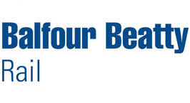
HOW CAN WE HELP YOUR EMPLOYEES?
The following Rail organisations are already actively involved in the organisation of the society:
Derby Railway Engineering Society acts as an educator to young railway professionals.
Your employees can learn and network with like-minded professionals from other local railway organisations.

Slide 9
INVOLVEMENT OF KEY INDUSTRY FIGURES
The society is fortunate to be able to call upon the expertise of some of the industries most prominent decision-makers in the industry
The society is fortunate to be able to call upon the expertise and support of the rail industry's most prominent decision-makers
The following colleagues are actively involved with the Society either as a Committee Member or as a Vice President
  Neil Andrew
  Carol Dixon
  Neil Foster
  Martin Giles
  Paul Long
  Stephen Pell
  Colin Scott
  Kerry Warburton
  Jonathan Wragg
  Chris Wright

Slide 10
HOW DOES DRES FIT WITH OTHER ENGINEERING INSTITUTIONS AND RAILWAY CENTRED SOCIETIES?
We work closely with:-
  The IMechE Railway Division
  Rail Forum
  Young Railway Professionals
  Women In Rail
Our USPs are:-
  A broad membership demographic, allowing for sharing of knowledge across generations of railway professionals
  A focus on all engineering disciplines
  A broad cross-section of topics rather than in-depth specialisations

Slide 11
PERCIEVED BENIFITS – A SUMMARY
Certified CPD for Staff.
Promotes ‘thought leadership’ and general technical development across a wide range of railway engineering disciplines.
Access to a broad cross section of railway companies – gives a broad prospective.
Provides a development opportunity for ‘younger’ colleagues
  Engagement and networking with an experienced cohort of members
  Development opportunity via DRES Committee membership
  Complementary management skills alongside technical skill – marketing, finance, people management etc
Cost effective compared to other professional institutions.
Supports the Derby Rail Industry
  Long term resourcing through an outreach programme
  Ability to promote company within a wider cohort

Slide 12
Interested in Joining?
Please Contact David Saunders or any other DRES Committee Member or Vice President
David Saunders
Membership Secretary
Email : membership@dres.org.uk

